Slide 2
Deep Learning
Introduction
Logistic Regression
Swallow Neural Networks
Deep Neural networks
Tensorflow
Project

Slide 3

1.1 What is a Neural Network

Slide 4
Housing Price Prediction
price
size of house

Slide 5
Housing Price Prediction

Slide 6

Housing Price Prediction
size
$$x_{1}$$
#bedrooms
$$x_{2}$$
y
zip code
$$x_{3}$$
wealth
$$x_{4}$$

Slide 7

1.2 Supervised Learning and Neural Networks

Slide 8
Supervised Learning
Input(x)
Output (y)
Application
Home features
Price
Real Estate
Ad, user info
Click on ad? (0/1)
Online Advertising
Image
Object (1,…,1000)
Photo tagging
Audio
Text transcript
Speech recognition
English
Chinese
Machine translation
Image, Radar info
Position of other cars
Autonomous driving

Slide 9
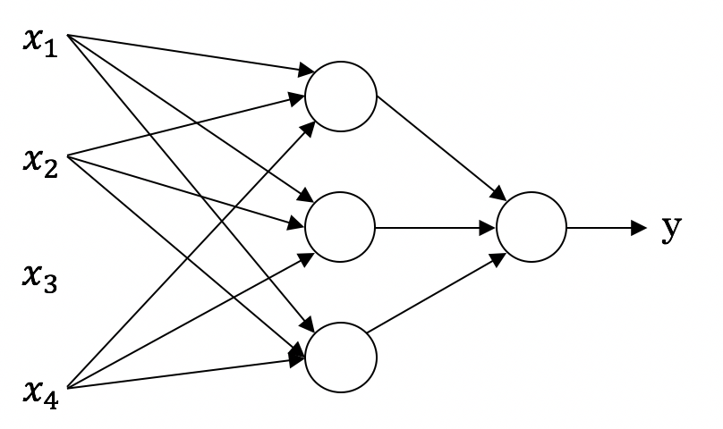
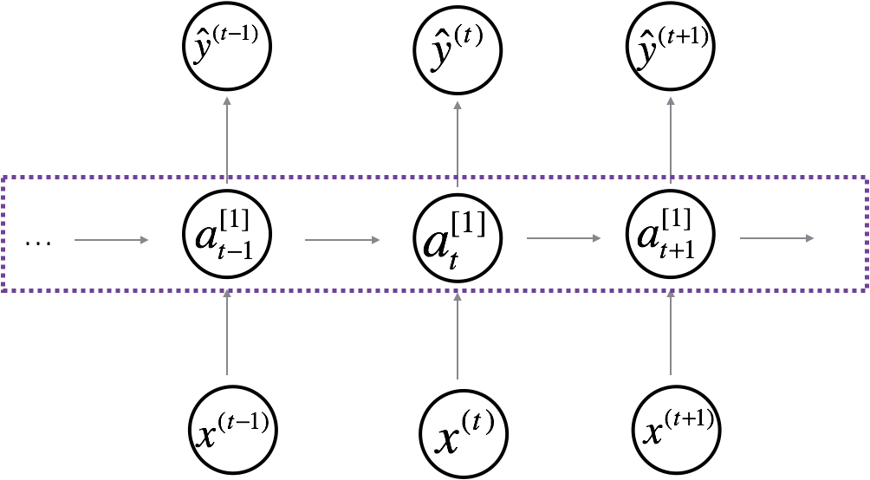
Neural Network examples
Standard NN
Convolutional NN
Recurrent NN

Slide 10

Supervised Learning
Structured Data
Unstructured Data
Size | #bedrooms | … | Price (1000$s)
2104 1600 2400 ⋮ 3000 | 3 3 3 ⋮ 4 |  | 400 330 369 ⋮ 540
Audio
Image
User Age | Ad Id | … | Click
41 80 18 ⋮ 27 | 93242 93287 87312 ⋮ 71244 |  | 1 0 1 ⋮ 1
Four scores and seven years ago…
Text

